Slide 1

Interpreting the life-cycles of 20-50 solar mass stars
James Bell, Cameron Macfarlane,Hiro Mori, Liam Robertson, Etienne Sadeghpoor

Slide 2
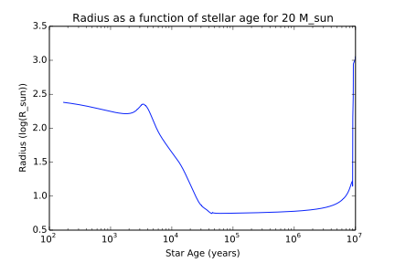
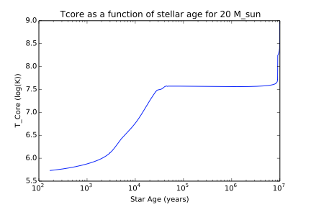
Pre-Main Sequence
As radius decreases, temperature increases

Slide 3

Pre-Main Sequence
Pre-Main sequence lifetime decreases with mass

Slide 4
Zero Age Main Sequence
Time when star first joins main sequence
Massive stars reach ZAMS whilst still accreting gas
Core temperature is high enough to initiate hydrogen fusion to helium
Star becomes quite stable

Slide 5
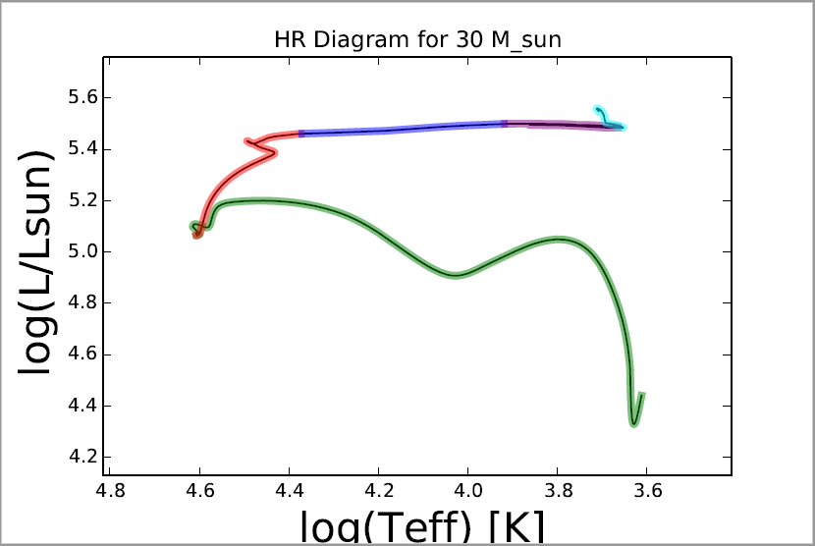
Main Sequence
Mass of star | 20M☉ | 30M☉ | 40M☉ | 50M☉
Lifetime of Main Sequence (years) | 8.9E+06 | 6.1E+06 | 5.0E+06 | 4.3E+06
𝛕 ～10^6 years
Longest stage of stars life
More massive stars spend less time on main sequence
MS
PMS

Slide 6
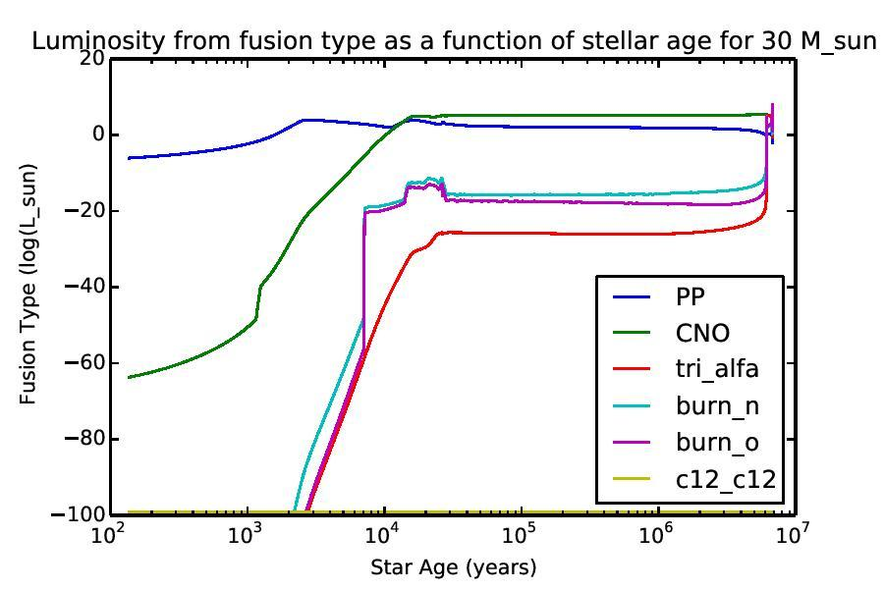
Main Sequence
Hydrogen core burning
H to He via predominantly CNO cycle
Stellar Winds greatly affect high mass stars
Notes:
Stars of initial mass exceeding 30M8 have so powerful stellar winds as to result in mass-loss timescales M/Mshorter than main-sequence timescales MQ/L. Consequently, their main-sequence evolutionary paths converge toward that of a 30M8 star. In particular, the extent of the helium core at the end of the main- sequence phase is similar, and hence so are the ensuing evolutionary stages.

Slide 7
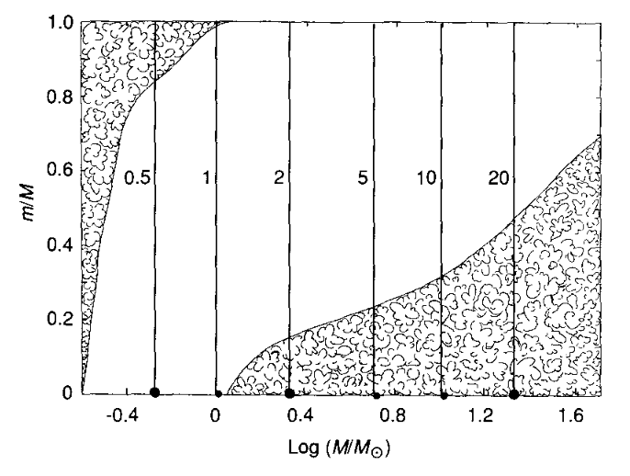
Main Sequence
Convective Core
Radiative Envelope
Right - Kippenhahn diagram for MS star with varying stellar mass from Prialnik Chapter 9

Slide 8
Giant Branch
H is exhausted in core
Core mass > Schonberg-Chandrasekhar limit
→ core collapses and heats up
H fusion shifted to shell surrounding core (still via CNO)
𝛕 ～10^4 years - ‘Transition’ phases where no core fusion occurs are rapid

Slide 9
Giant Branch
GB
Virial theorem still holds
1) envelope expands - E_grav
2) envelope cools - E_thermal
T_eff decreases → moves to right on HR diagram
L is close to L_edd → L remains constant

Slide 10
Horizontal Branch (Core He burning)
𝛕 ～10^5 years - fusion provides stability
He begins to fuse gradually with increasing core temp
Electrons in core do not become degenerate
No He flash
AGB
HB
Notes:
Horizontal Branch
For high mass stars core Helium fusion begins gradually without a helium flash as the core of the star does not become degenerate. The stage in which helium burns in the core is known as the horizontal branch. In this stage helium burns in the core of the star through the triple alpha process while hydrogen burns in shells via the CNO cycle. The star moves to the right of the HR diagram as the effective temperature continues to decrease. This stage lasts for approximately 10^4 years and is shown in purple on the HR Diagram. As mentioned previously stars with Mass over 30 solar masses lose so much mass that their evolutionary paths converge to that of a 30 solar mass star so there is not much variation between masses in our range.
For high mass stars there is a huge amount of mass loss in the horizontal branch due to rapid stellar winds and this is shown on the graph for a 20 solar mass star which loses about 30% of its mass in this phase.
After the star has fused all the helium in the core the star moves onto the asymptotic giant branch, this lasts about 10% of the time of the horizontal branch and is shown as the light blue on the HR diagram.

Slide 11
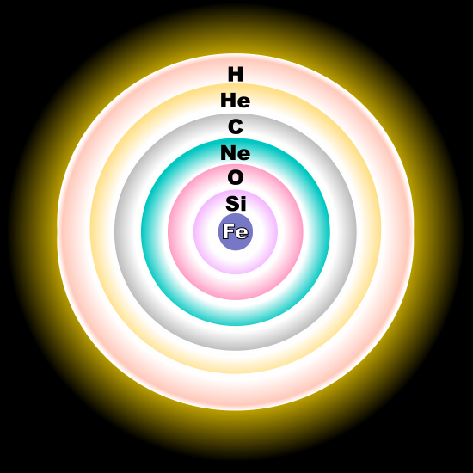
Asymptotic Giant Branch
Asymptotic branch timescale:
10^3 yrs
Luminosity is almost at Eddington luminosity
Progressive burning of heavier elements
Each burning phase increases in speed.
Notes:
AGB
At the start of this stage the core is inert while shell helium and hydrogen fusion occurs. As in the red giant branch the inert core begins to contract and the envelope expands to a larger size than before, however in this expansion, as Cameron mentioned the luminosity is almost constant as the star is almost at the Eddington luminosity. Eventually the core becomes hot enough to fuse carbon. The carbon burning phase is much quicker than previous phases as it must compensate for the energy loss due to neutrino emission which occurs as the temperature is so high and the fusion of heavier elements releases less energy. After carbon runs out in the core the process of expansion repeats again resulting in oxygen fusion and then finally to Silicon fusion, the core will only become degenerate when it consists of an inert core of iron. While these further core fusion stages go on, shell fusion of the other elements occur creating an onion structure of fusing shells as shown on the slide.
In high mass stars the different fusion processes occur too rapidly for thermal pulses to occur as the perturbations do not reach the surface of the star quickly enough.

Slide 12
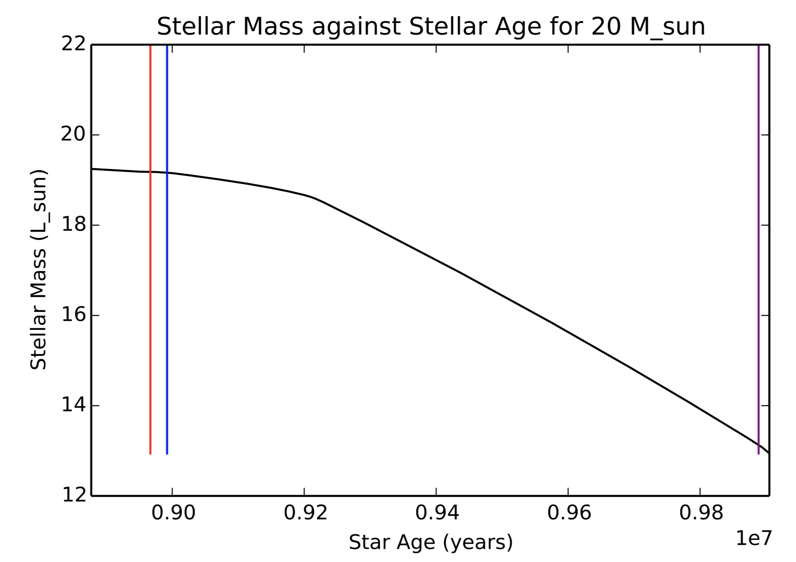
End Product
Initial mass | 20☉ | 30☉ | 40☉ | 50☉
Final total mass before the simulation ends | 12.0☉ | 15.9☉ | 34.0☉ | 39.2☉
Final core mass | 4.8☉ | 6.4☉ | 13.6☉ | 15.6☉
Contraction of Iron core results in Supernova explosion.
SN type 2 for this range (80 solar mass >M)
Polytrope n=3 model assumed
Core mass > 3 solar mass → BH in theory
Mass loss rate M/M_dot exceed the MS time scale MQ/L
GB
HB
MS
Notes:
The contraction of the inert iron core will cause the star to collapse in a supernova explosion, this occurs for all stars in our mass range. B

Slide 13
Summary
Pre MS - 10^4 yr (cf solar mass 10^7 yr)
MS - 10^6
H → He via CNO cycle
Convective core, radiative envelope
GB - 10^4 yr
Constant luminosity, decreasing T → moves to right on HR
HB - 10^5 yr
He fusion begins gradually via triple alpha → NO He FLASH!
AGB - 10^3 yr
Progressive burning of heavier elements - each burning phase increases in speed
Onion structure
End product
SN II → BH

Slide 14
Nuclear Core Fuel
PMS: no nuclear fusion
MS: H core fusion. CNO dominate over p-p chain as T is high
RGB: H shell fusion. No core fusion
HB:He core fusion, triple alpha
AGB: He and other shell burning until Fe is reached at the core-> SN
BH: No nuclear fusion(As far as we know)

